Slide 1

Corona Virus Outbreak Prediction Using Deep Learning
.

Slide 2
Team Members
Sai Deva Pranay Kumar Rao | 700745063
Praneeth Kumar Annapureddy | 700747594
Sreeya Gutta | 700745419
Meghana Reddy Guvvanthula | 700745727

Slide 3
Roles and Responsibilities
Meghana – Collection of data from various sources & Filtering data to make sure it is noise free
Sreeya – Training and Testing the model and worked on the final PPT presentation
Pranay – Implementation & worked on the final IEEE paperReport making
Praneeth – Validation & contributed for final IEEE paper

Slide 4
Motivation
The increasing cases and it’s results of numerous death led to the implementation of this project.
The availability of the large-scale datasets in the market.
Early detection of covid by using the project can help take precaution.
Chest radiography(X-Ray) is one of the trust worthy methods.
Basic knowledge on the CNN
Research on Pneumonia, TB

Slide 5
Objectives
Predict the person is positive to the virus or not by
Developing a deep learning model using CNN
Gathering the necessary information
Applying the model
To gain the optimal efficiency, increase the accuracy, reduce the time complexity
Early detection

Slide 6
Related Work
The image processing, feature extraction, and classification methods employed in the development of each system cause them to differ from one another.
Rapid Antigen Tests: These tests provide quick results but may be less sensitive than RT-PCR tests. Studies have evaluated their accuracy and effectiveness in different settings.
Machine Learning for Diagnosis: AI and machine learning algorithms have been developed to assist in diagnosing COVID-19 from chest X-rays and CT scans, aiming to reduce the workload on radiologists.

Slide 7
Problem statement
The study aims to predict the status of the patient either positive or negative to the disease based on the severity. Additionally, it also evaluates the highness of the symptoms, classifying them based on their ranges with an accompanying accuracy calculation.
Data filtering, processing training and testing(80-20% ratio) is done to obtain the desired result.

Slide 8
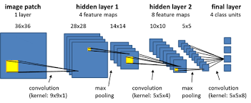
Proposed solution
Algorithm
CNN (Convolutional neural network) is a deep learning networking architecture that learns directly from data.
This is considered as the most effective algorithm for image classification, retrieval, and detection tasks.

Slide 9
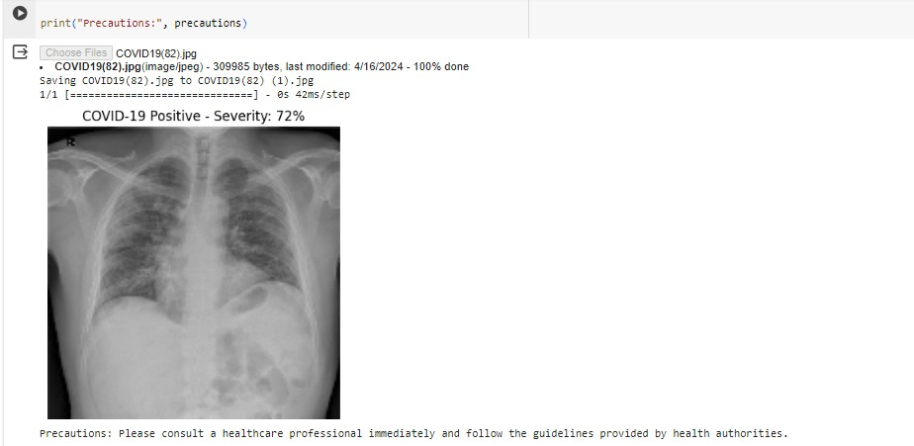
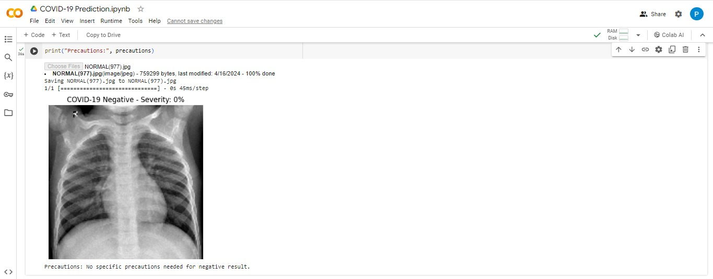
Results

Slide 10
Future Scope
There are those who contract the virus for the first time and those who continue to experience symptoms even years of infection.
This project can even further be developed when they are any new symptoms traced or any similar kind of pandemic emerges.

Slide 11
References
https://ieeexplore.ieee.org/document/9716478
https://www.ncbi.nlm.nih.gov/pmc/articles/PMC8286881/
https://www.datacamp.com/tutorial/introduction-to-convolutional-neural-networks-cnns>
https://www.kaggle.com/datasets?search=covid+-19

Slide 12
THANK YOU
.

